Slide 1


CactusCon 2022 Badge
Badge Overview

Slide 2
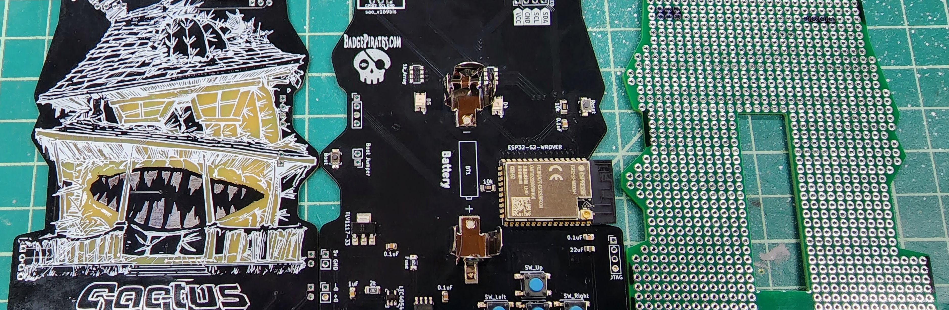
CactusCon 2022 Badge

Slide 3
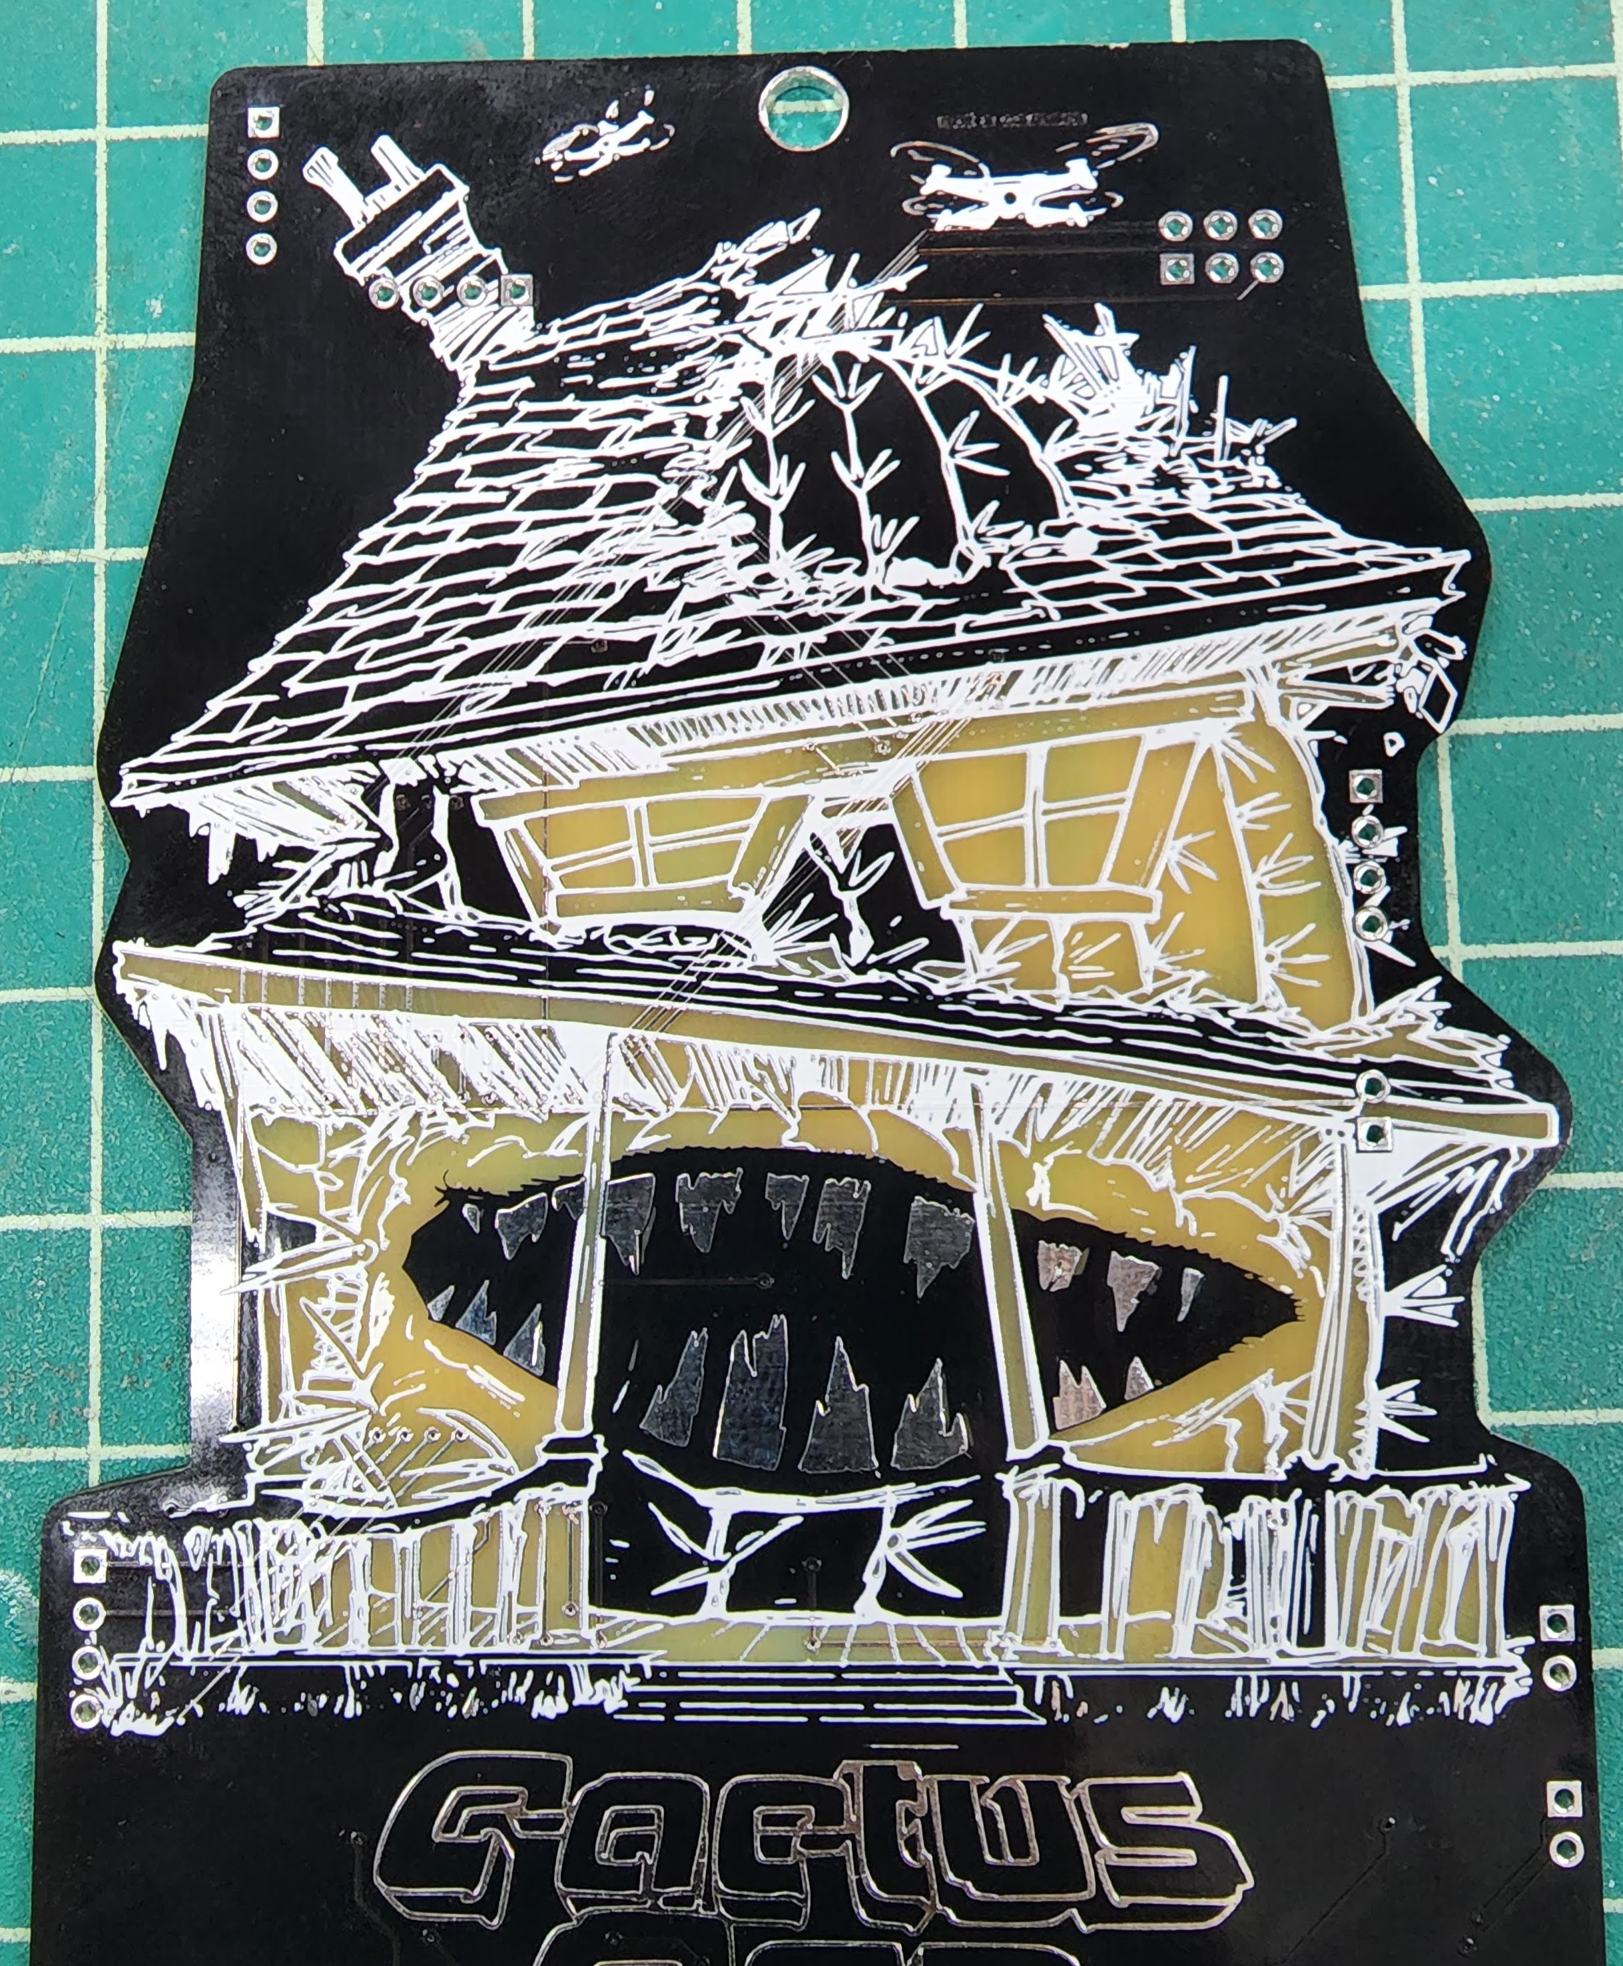
Artwork
Designed based on t-shirt artwork
Mixed PCB Layers (FR4/Copper/Silkscreen/Soldermask)

Slide 4
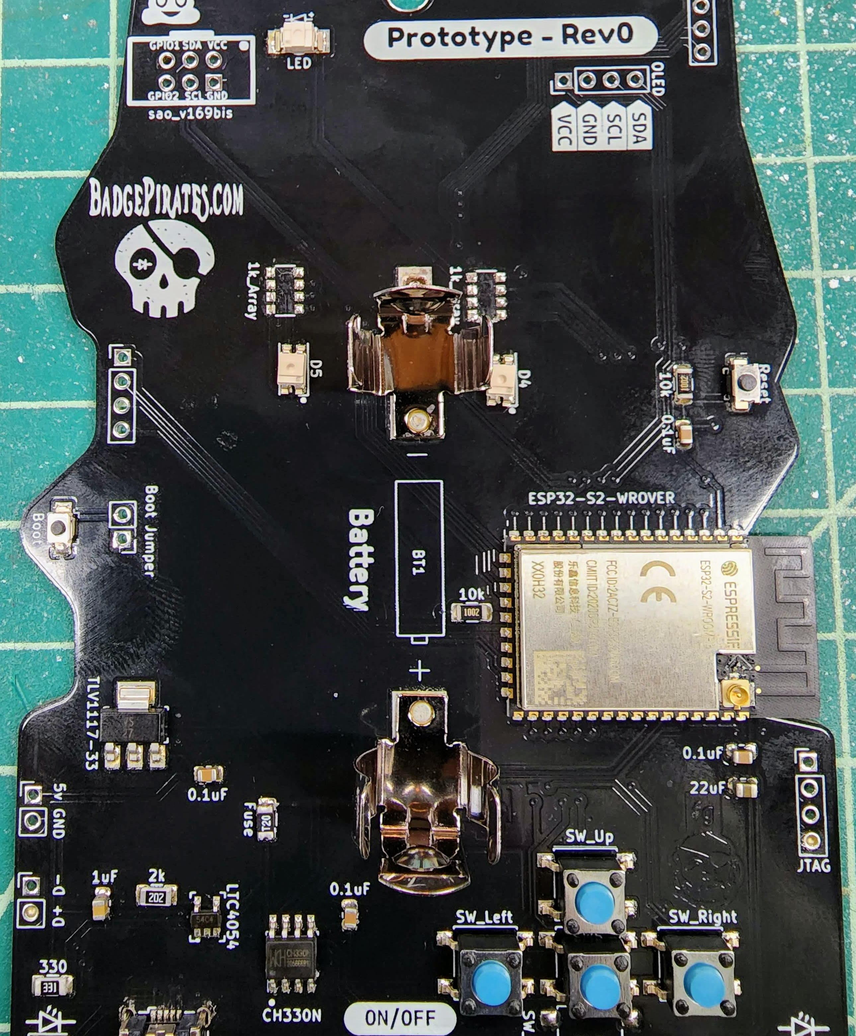
Hardware
Microcontroller: ESP32-S2 WROVER
Wireless Communications: WIFI (2.4Ghz)
Power: 3.3V (Battery + USB – voltage regulator)
Battery: 1x rechargeable Li-Ion 14500 (onboard charging via USB)
Indicators: 2x reverse mount RGB LED, 1 reverse mount LED, power and charging LEDs
Input: 5x push buttons (rear)
I/O: 43 GPIO pins (22 usable)
Programming: USB to Serial TTL (onboard) – MicroUSB

Slide 5
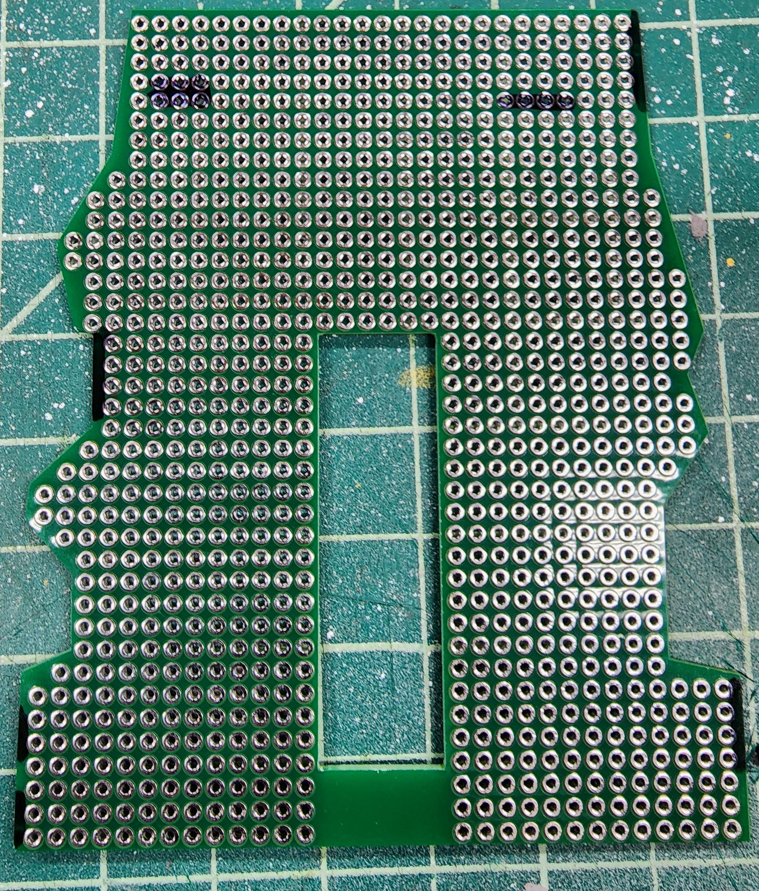
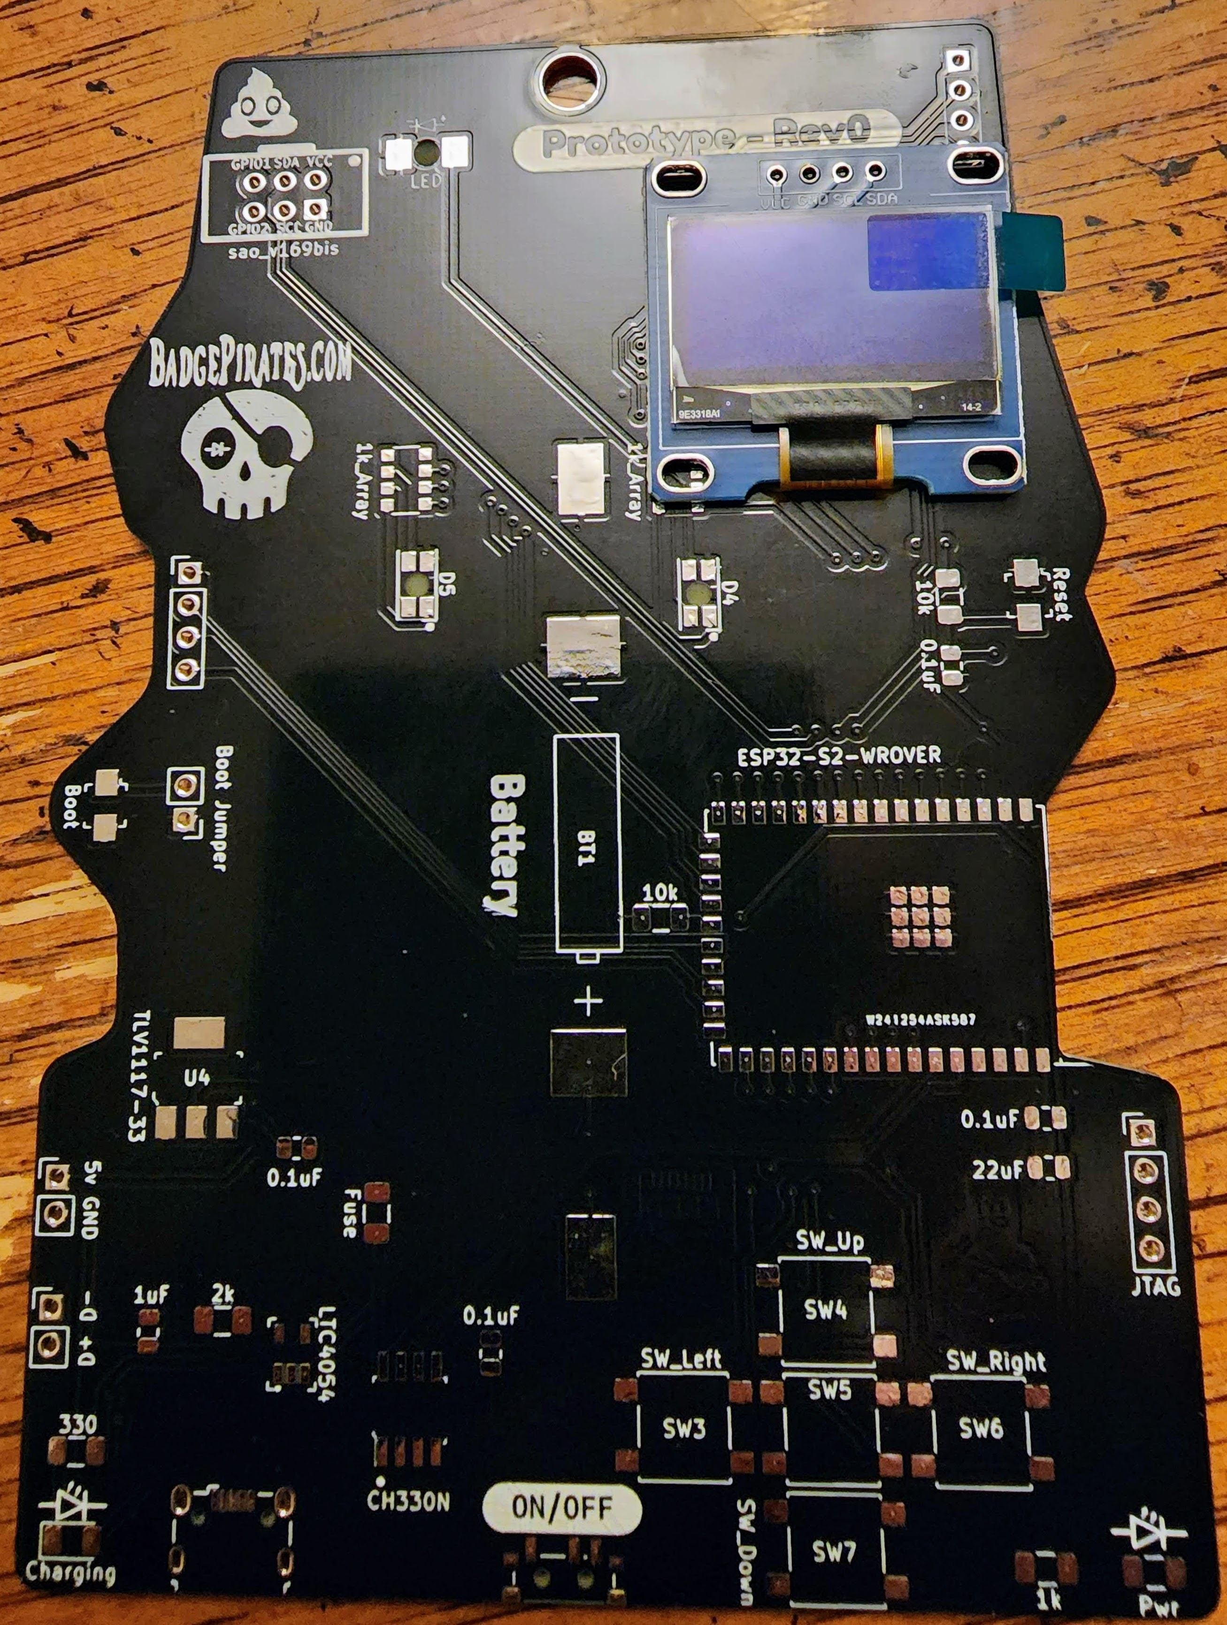
Extensibility
Support for SSD1306 display (rear)
Expansion PCB (rear mounted)

